Slide 1
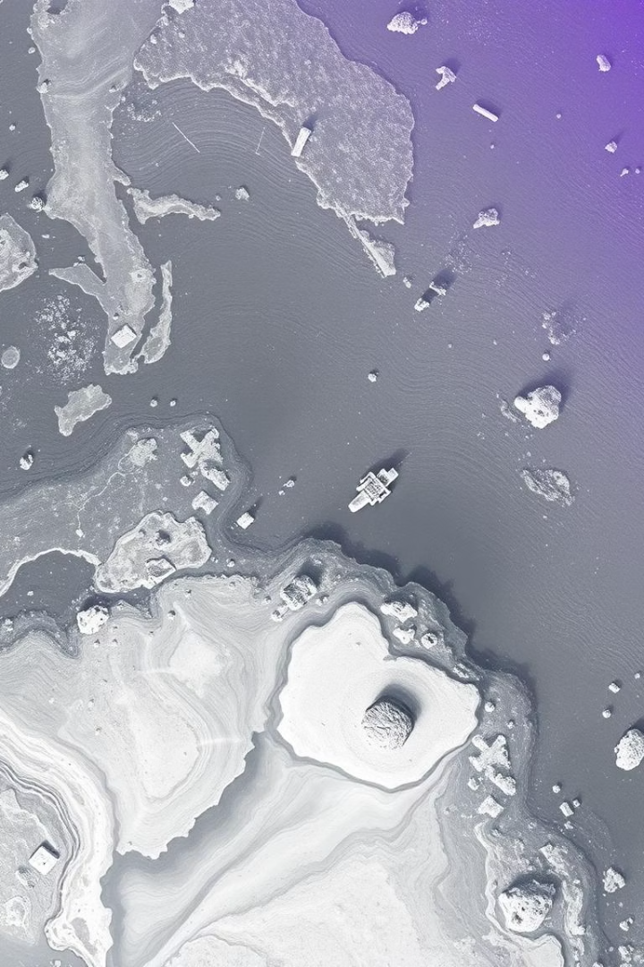
SAR Image Denoising and Colorization using DnCNN and Ensemble Encoder

Slide 2

Introduction to SAR Imagery
SAR Technology
Advantages
Active remote sensing that captures images day and night.
Operates in all weather conditions, regardless of clouds or darkness.
Applications
Challenge
Used in earth observation, military, and disaster management.
Speckle noise severely degrades image quality and clarity.

Slide 3
The Problem: Speckle Noise and Lack of Color
Speckle Noise
Lack of Color
Multiplicative noise corrupting SAR image details.
SAR images are typically grayscale only.
Reduces interpretability and visual clarity.
Colorization improves feature discrimination and interpretation.

Slide 4
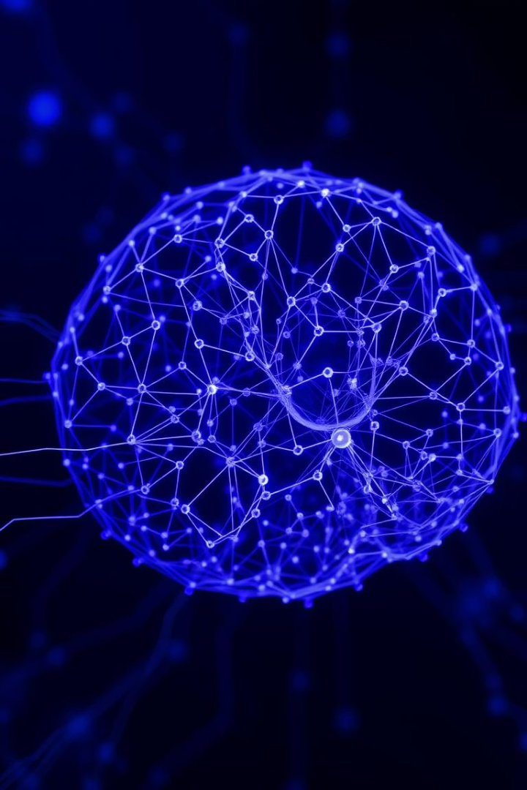
Deep Convolutional Neural Network (DnCNN) for Denoising
Key Features
Learns noise patterns directly from SAR data.
Uses residual learning for efficient, fast training.
Handles spatially varying noise effectively.
Delivers state-of-the-art denoising accuracy.

Slide 5
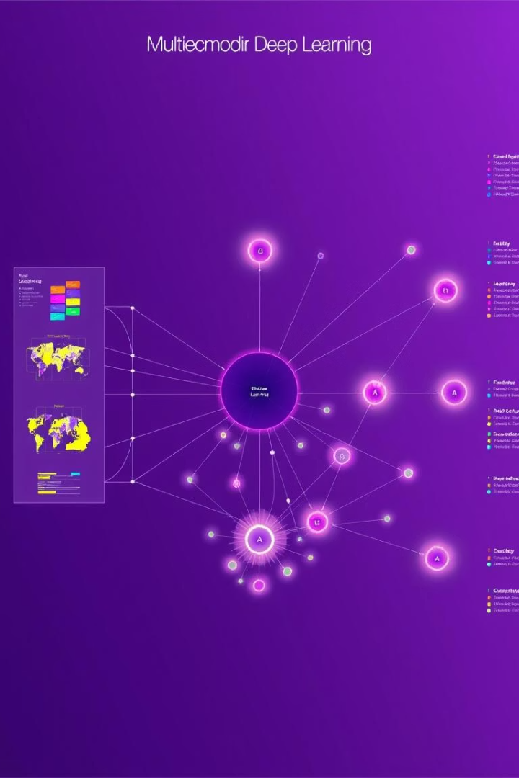
Ensemble Encoder for Colorization
Robust Feature Extraction
Effective Color Mapping
Enhances color fidelity and consistency in SAR images.
Uses multiple encoders to capture diverse image traits.
Benefits
Improves visual quality for better analysis and decisions.

Slide 6
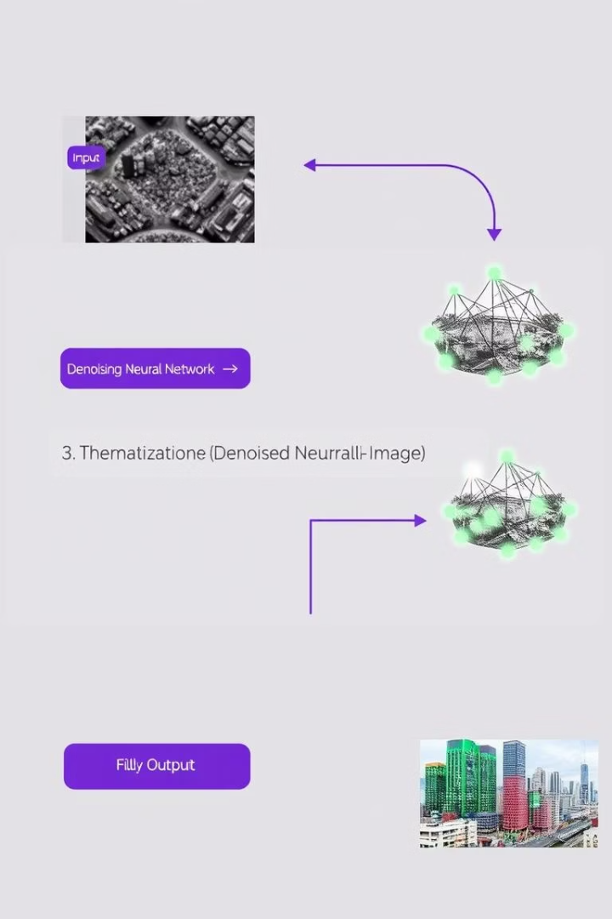



Proposed Methodology: DnCNN + Ensemble Encoder
Stage 1: DnCNN
Reduce speckle noise while preserving image details.
Stage 2: Ensemble Encoder
Apply colorization to denoised images with enhanced features.
Optimization
End-to-end training for joint denoising and colorization.

Slide 7
Dataset and Experimental Setup
Datasets
Evaluation Metrics
Implementation
Sentinel-1
PSNR (Peak Signal-to-Noise Ratio)
Details on software, hardware, and training parameters.
TerraSAR-X
SSIM (Structural Similarity Index)
CIQA (Color Image Quality Assessment)

Slide 8
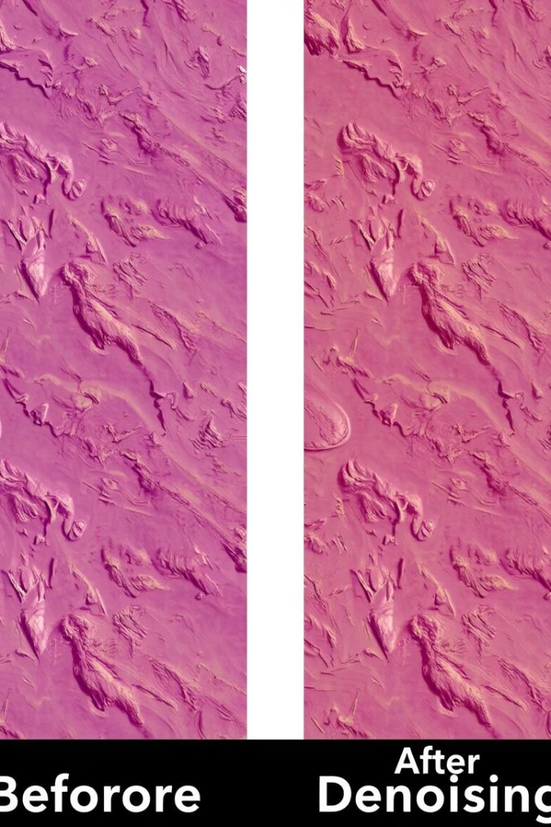
Results and Discussion: Denoising Performance
Quantitative Results
Visual Quality
Achieved higher PSNR and SSIM than existing methods.
Denoised images show clearer structures and less noise.
Effectiveness
DnCNN excels in modeling speckle noise variations.

Slide 9



Results and Discussion: Colorization Performance
Quantitative Scores
2
CIQA scores surpass baseline colorization methods.
Qualitative Assessment
Colorized images boost feature recognition and interpretation.
1
Ablation Study
3
Ensemble encoder impacts color consistency positively.

Slide 10
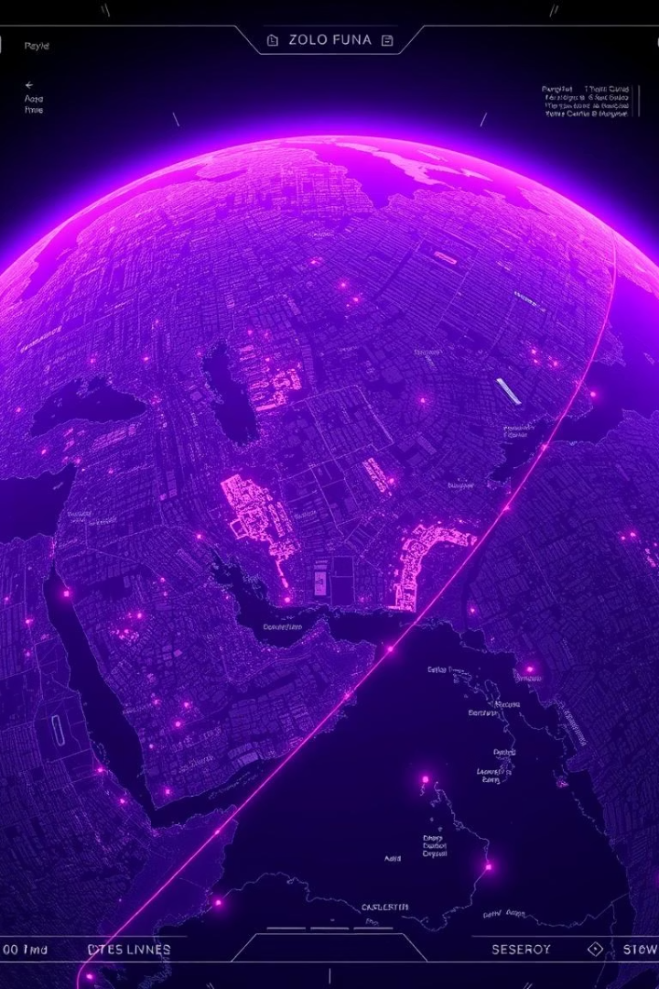
Conclusion
Framework Summary
Combines DnCNN denoising with ensemble encoder colorization.
Results
Outperforms current state-of-the-art methods in image quality.
Future Work
Explore real-time processing and expanded application domains.

